Slide 1
Time Series Clustering
May 30, 2016

Slide 2
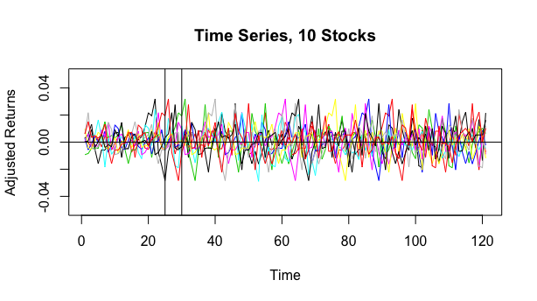
What are time series?

Slide 3
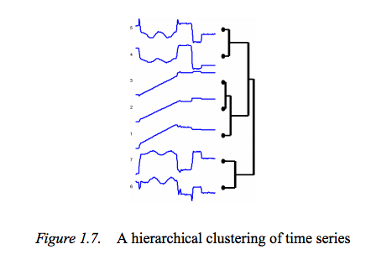
Time Series Clustering
Time Series Characteristics:
- Trend
- Cyclical
- Seasonal
- Random
http://i.stack.imgur.com/aqaVq.png

Slide 4

Time Series Clustering
The log returns, benchmarked against the TSX Index is the primary metric (Euclidean Metric).
The number of days following the IPO was used as the time Index.
The Euclidean distance between each time series was calculated, then a clustering algorithm grouped the closest time series together. day Stock 1 adjusted for TSX (=B3 - C3) Stock 2 adjusted for TSX Distance square

Slide 5
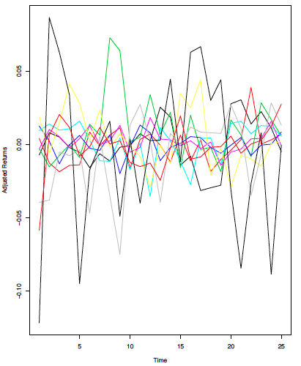
10 Time Series IPOs for first 25 days post IPO

Slide 6
Time Series Clustering for first 25 days
45%
-28%
-4.68%
5.78%
7.28%
0.03%
1.7%

Slide 7
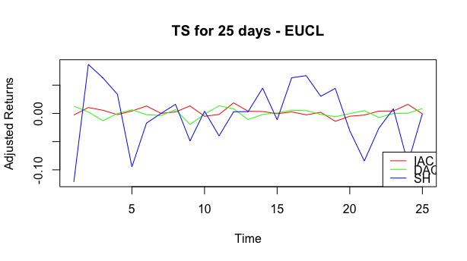
Closer look

Slide 8
First 25 days
30 – 120 days post IPO
First 25 days
30 to 120 days

Slide 9
Time Series Clustering for 30 – 120 days post IPO
-59%
-41%
21.64%
8.2%
1.7%
8.3%

Slide 10
Comparison
Days from 30 to 120 days
First 25 Days

Slide 11
Results
From 25 days, 60% of stocks retained at least 1 neighbour when clustering the 30 – 120 day returns.
From 25 days, 90% of stocks were grouped within 2 spots from at least 1 of their neighbours.

Slide 12
Conclusion
Time Series Clustering was a helpful tool for analysis.
Our analysis shows that the clusters of the first 25 days tend to extend to longer time periods (up to 120 days) for the majority of stocks.
Possible extension of the work:
Using intraday trading data, we could use time series clustering to find trends and similarities.

